Slide 1

Global positioning
Peter Galante
Biodiversity Informatics Scientist
Center for Biodiversity and Conservation
American Museum of Natural History

Slide 2
GNSS
Global Navigation Satellite System
Global Positioning System (GPS)
Most commercial GPS units
Russian Global Navigation Satellite System (GLONASS)
Can be added to commercial units
Galileo Positioning System (EU)

Slide 3
GPS
1960’s US Navy:
Satellite positioning of nuclear submarines using Doppler Effect radio shifts
1970’s Department of Defense:
NAVSTAR (Navigation System with Timing and Ranging)
24 Satellite constellation
1990’s – late 2010’s US Air Force:
30 satellites for public use (many retired, dormant)
Provides Standard Positioning Service (SPS)
Precise Positioning Service (PPS) is reserved for military use
2019 US Space Force:
Maintain and control operations
24 operational satellites

Slide 4

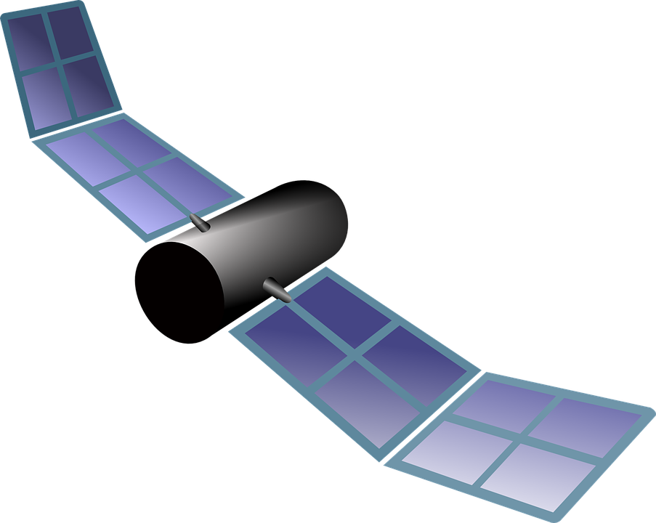
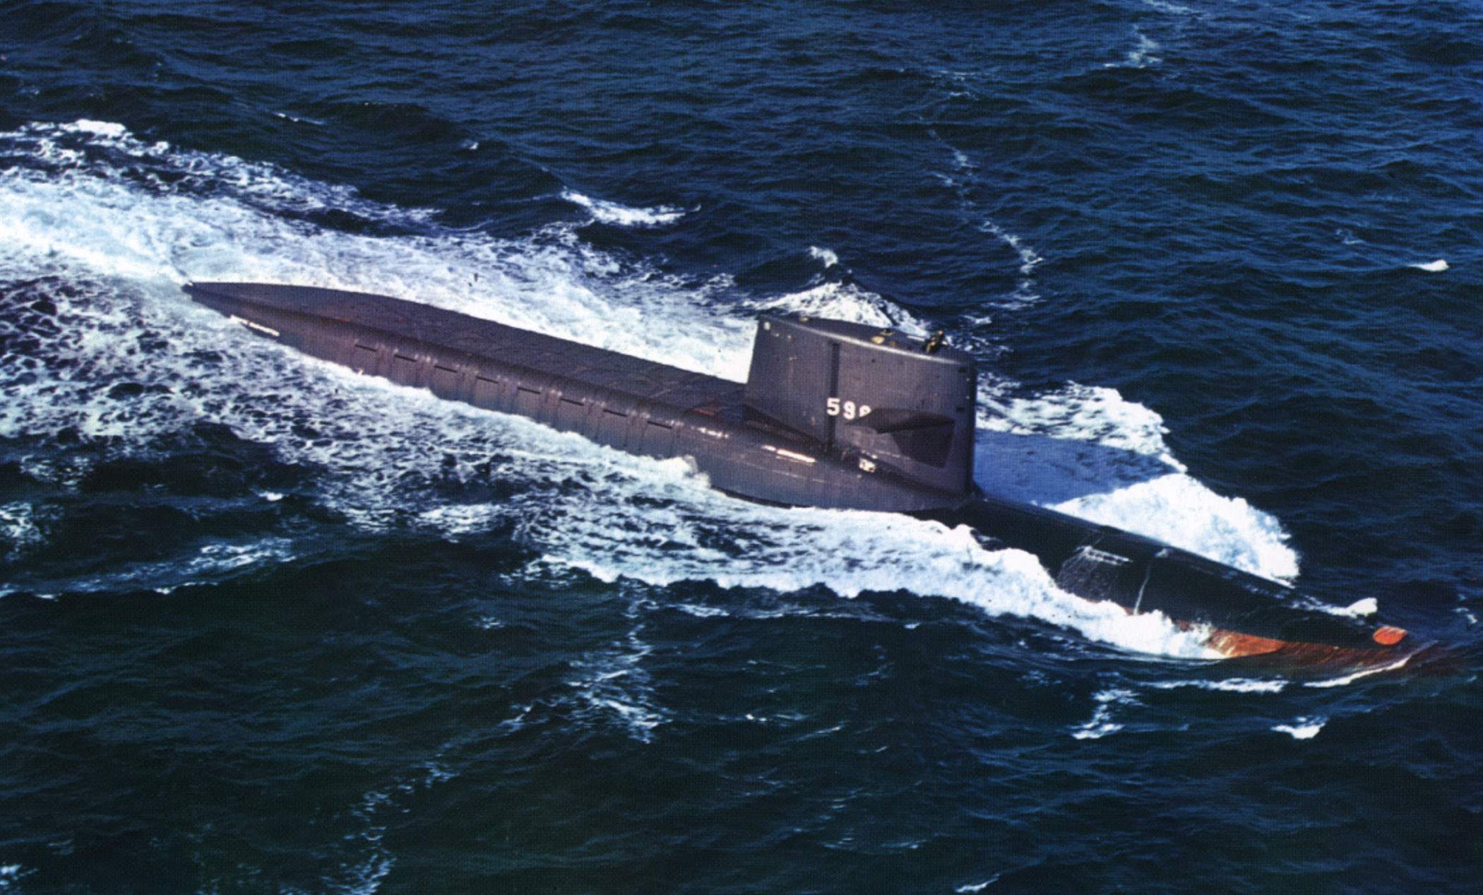
GPS
1960’s US Navy:
Satellite positioning of nuclear submarines using Doppler Effect radio shifts

Slide 5
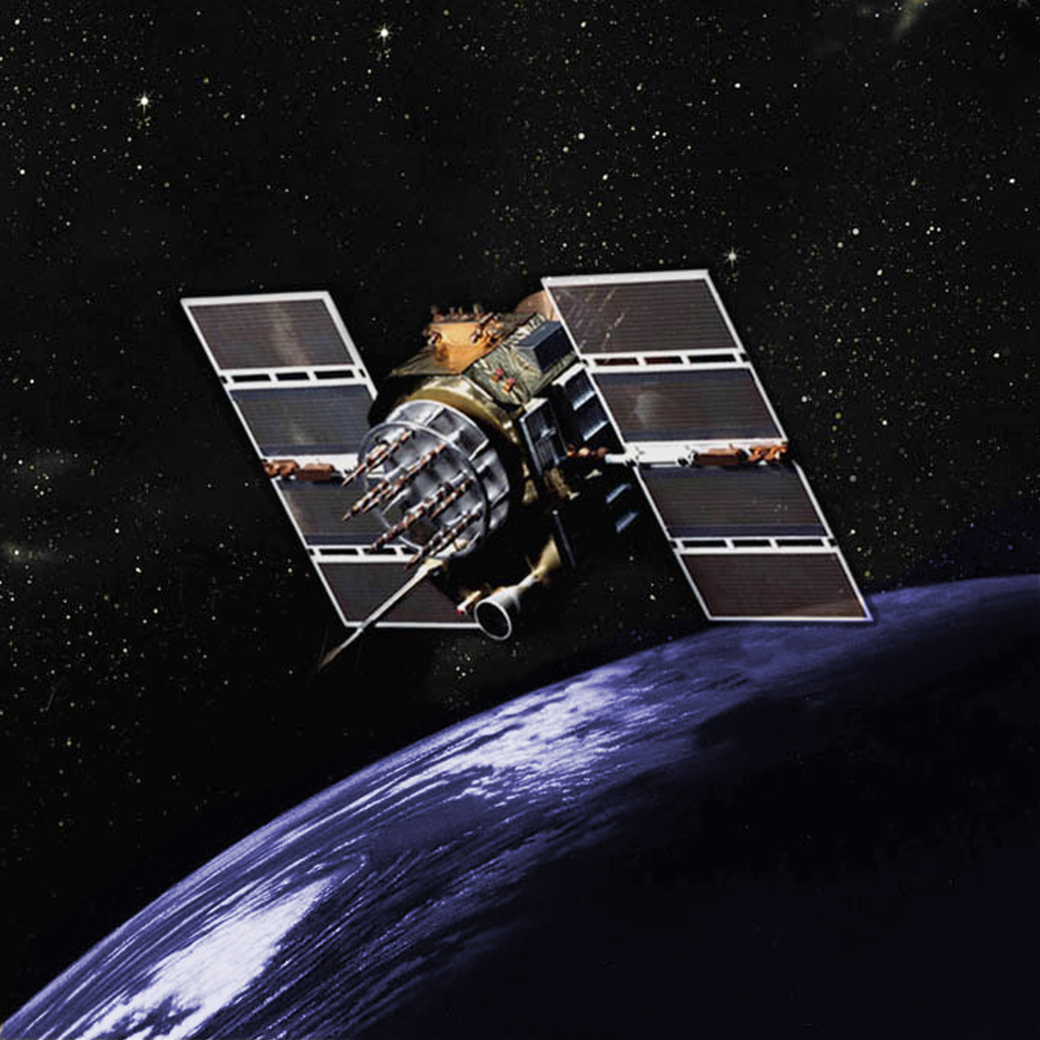
GPS
1970’s Department of Defense:
NAVSTAR (Navigation System with Timing and Ranging)
24 Satellite constellation
Completed in 1994
At least 5 Satellites in view from most point on earth at any giventime
Block II satellite

Slide 6
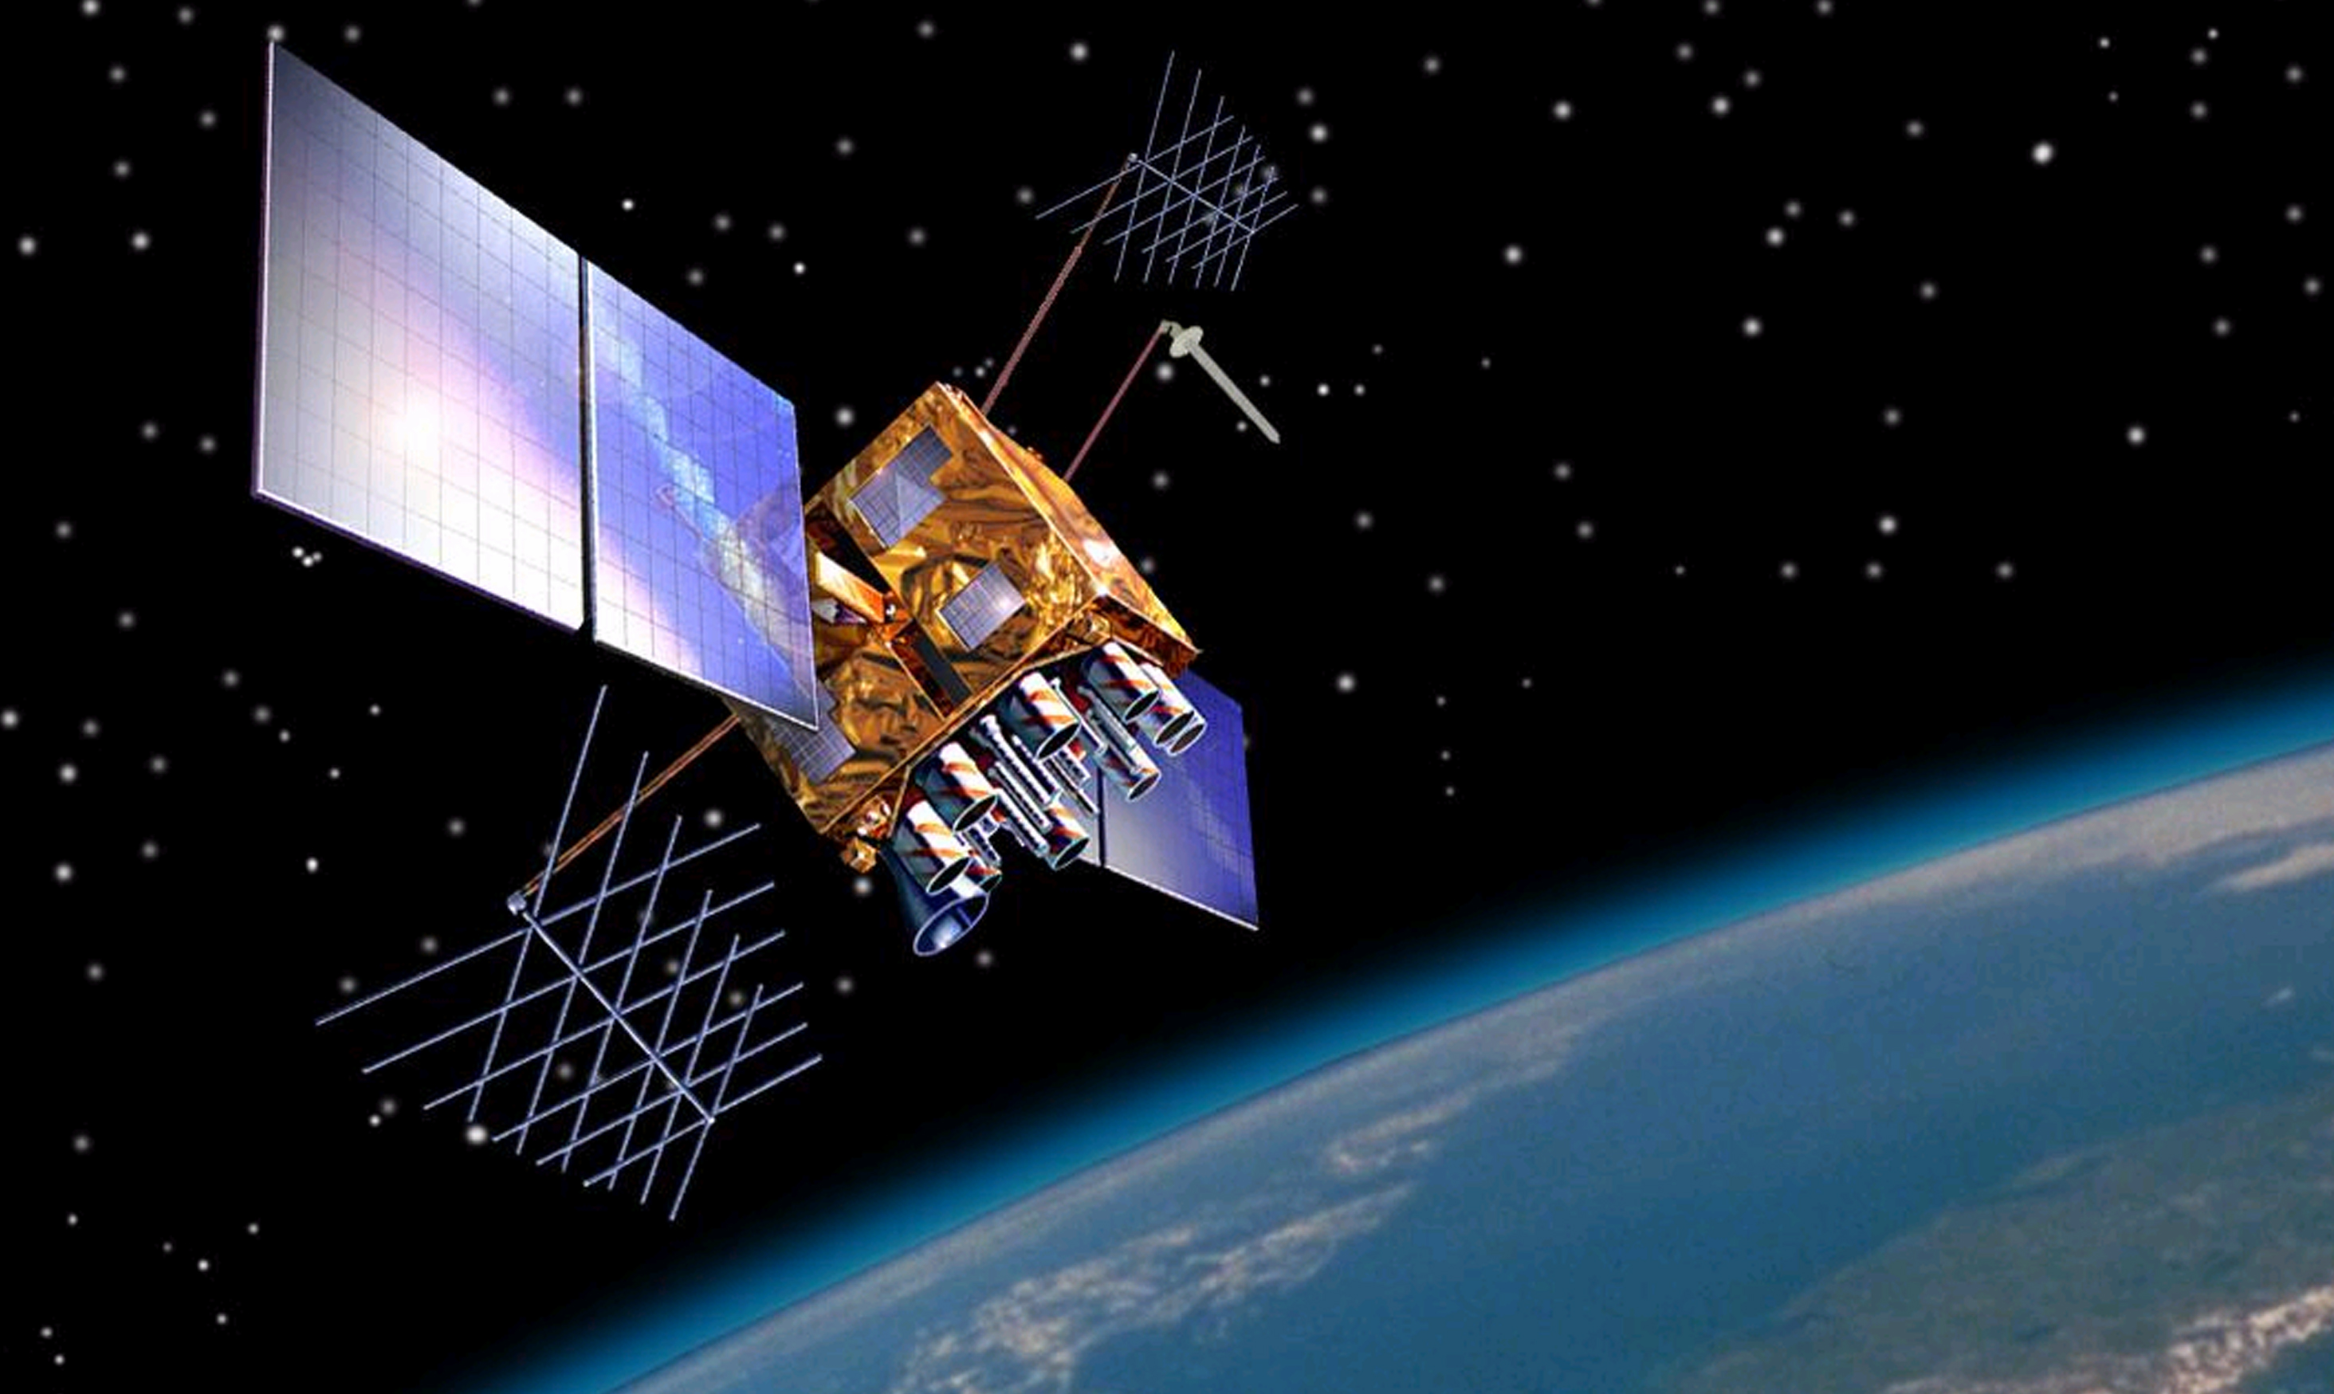
GPS
1990’s – late 2010’s US Air Force:
30 satellites for public use (many retired, dormant)
Updated to Block III Satellites
Provides Standard Positioning Service (SPS)
Precise Positioning Service (PPS) is reserved for military use
Block III satellite

Slide 7
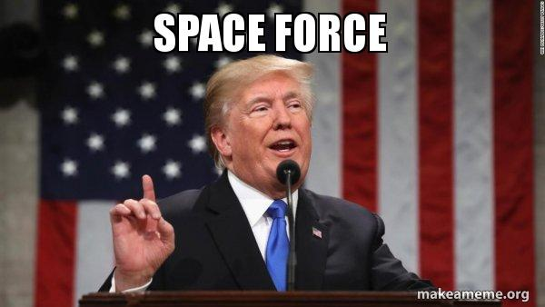

GPS
2019 US Space Force:
Maintain and control operations
24 operational satellites

Slide 8
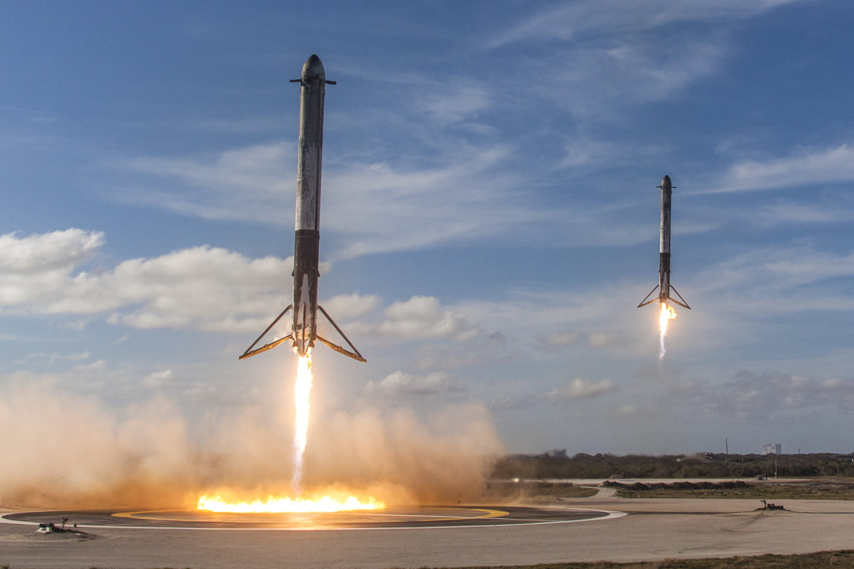
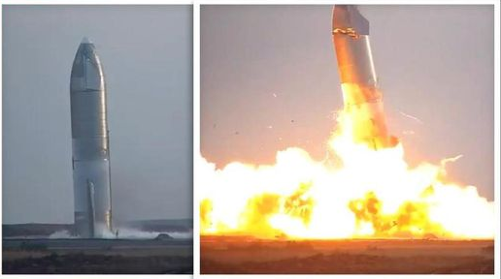
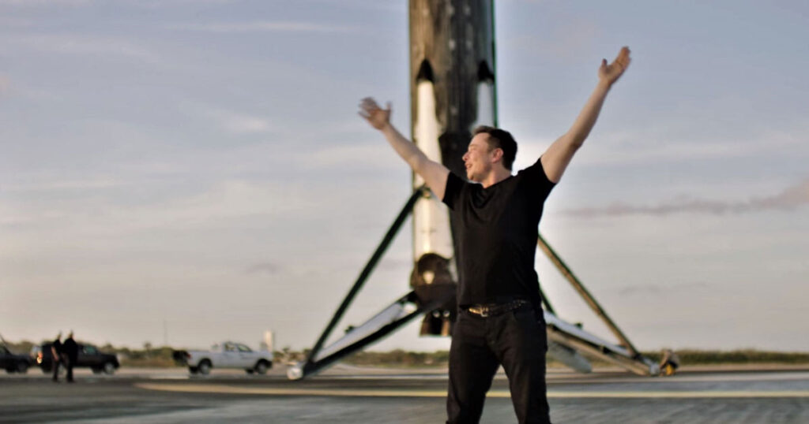
GPS
Future:
New civilian signals for improved applications (aviation, safety)
Private industries
Regulations?
Space junk accumulation
Success
Rough start

Slide 9
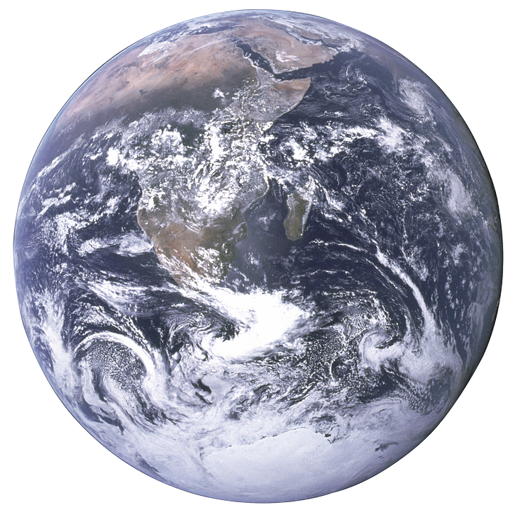
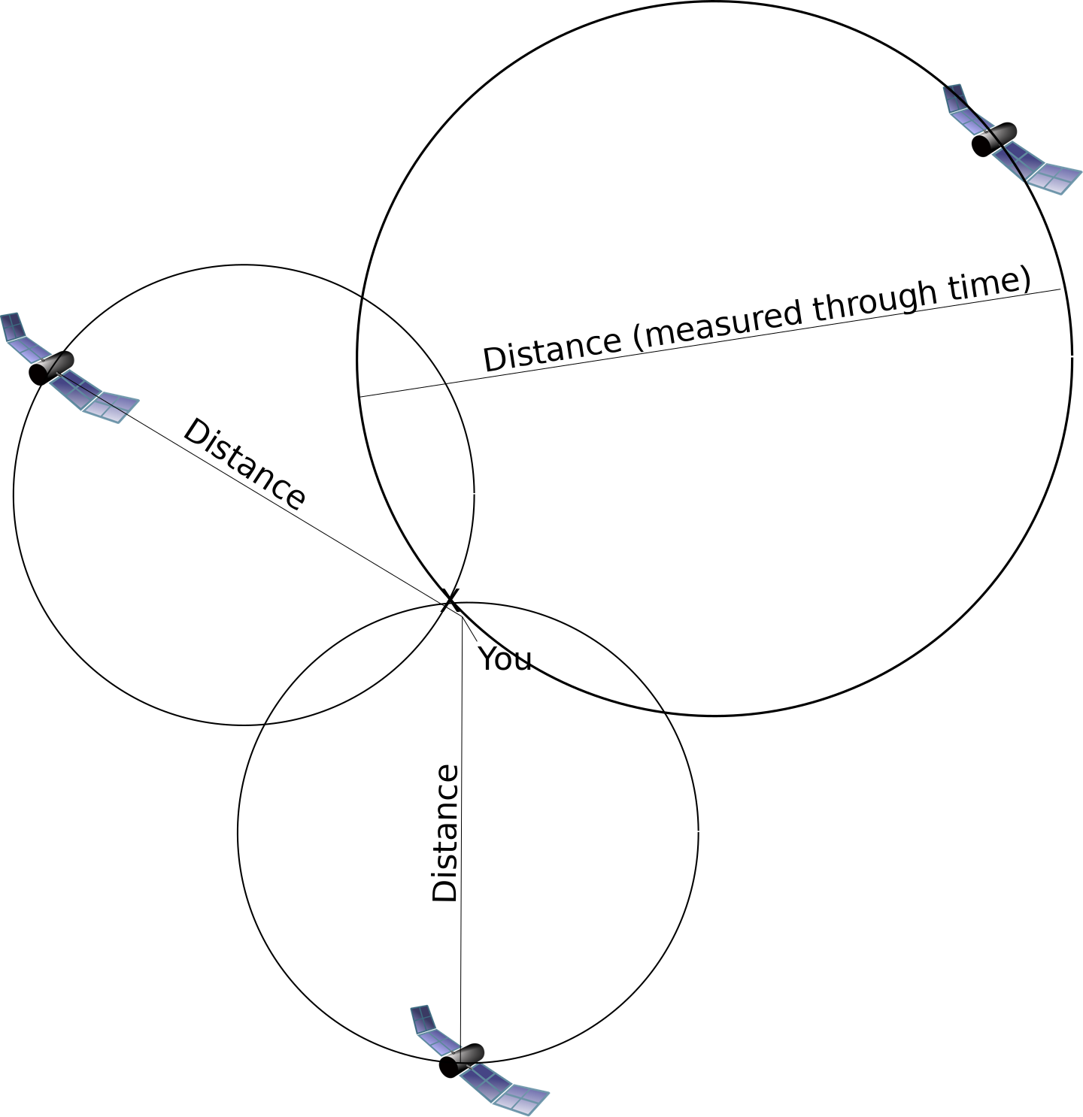
GPS
More satellites = less error

Slide 10
GPS
Converting time to distance
GPS unit computes its own location using data received from satellite
Receiver must have a reliable clock
Satellite sends its own precise location, and an atomically calibrated timestamp
Receiver then calculates its distance from that satellite
Time received - time sent = time difference
Time difference x 299,782,458 meters/second = distance
Do this for multiple satellites = accurate 3D location
Minimum, 4 satellites

Slide 11
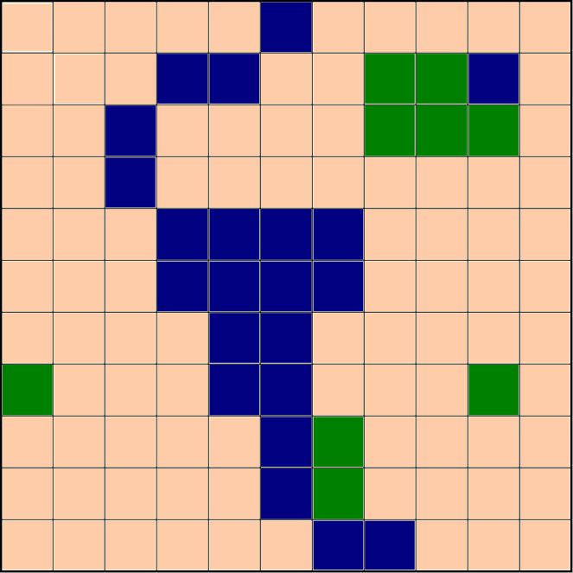
GPS
Can be used to directly generate vector data
- Point data (long, lat)
- Tracks can be used to create lines (roads/rivers) and polygons (buildings, fields, forests)

